Slide 1
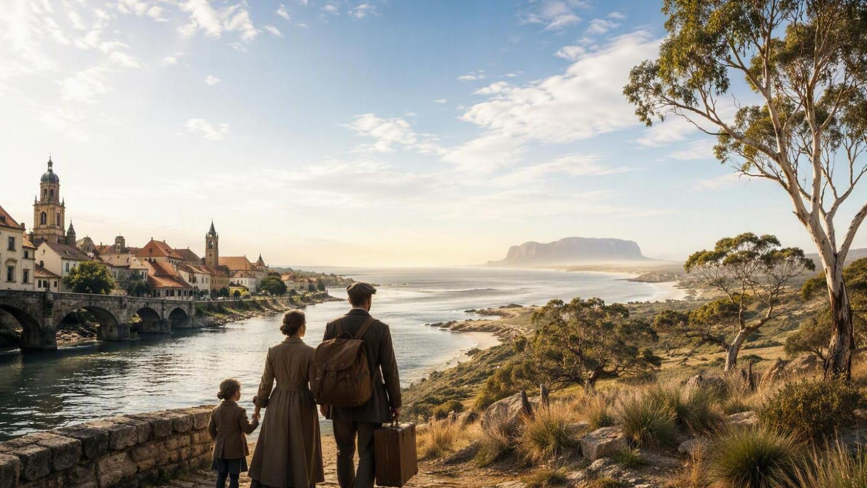
A REFUGEE'S JOURNEY · POLAND TO AUSTRALIA
From Refugee
to Human Rights Commissioner
The journey of Professor Seweryn “Sev” Ozdowski AM
Born Poznań, Poland, 1949 • Arrived Sydney, 18 June 1975

Slide 2
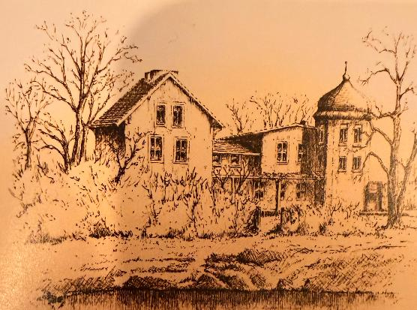
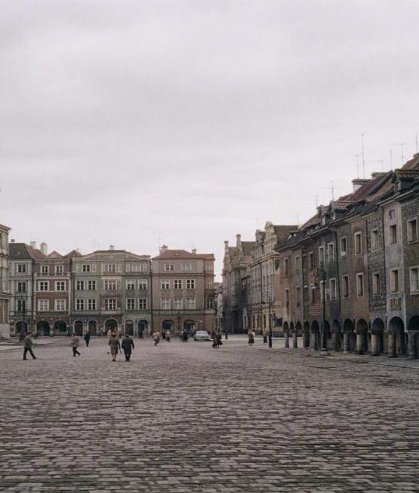
CHAPTER ONE · POLAND
Roots in Poznań
Born 24 June 1949 in Poland, Seweryn Antoni Ozdowski grew up to become a scholar of law and society at one of the country’s great universities.
Master of Laws (Hons.)
Adam Mickiewicz University, Poznań — 1971
Master of Arts in Sociology (Hons.)
Adam Mickiewicz University, Poznań — 1973
Research Officer
Institute of Legal Studies, Polish Academy of Sciences, Warsaw — 1971–73

Slide 3
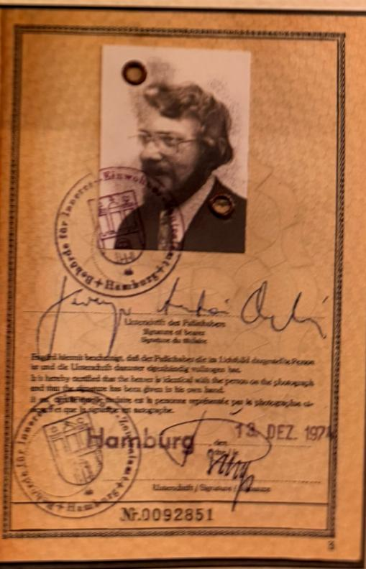
CHAPTER TWO · EXILE
Two Years in Limbo
Departed Poland — June 1973
The family spent two years as refugees in West Germany, where son Adam was born in Hamburg and Seweryn undertook postgraduate study at the University of Hamburg.
A one-way passage
They travelled on “no return” German documents after the Polish People’s Republic refused to renew their passports — overjoyed when Australia accepted them for migration.

Slide 4
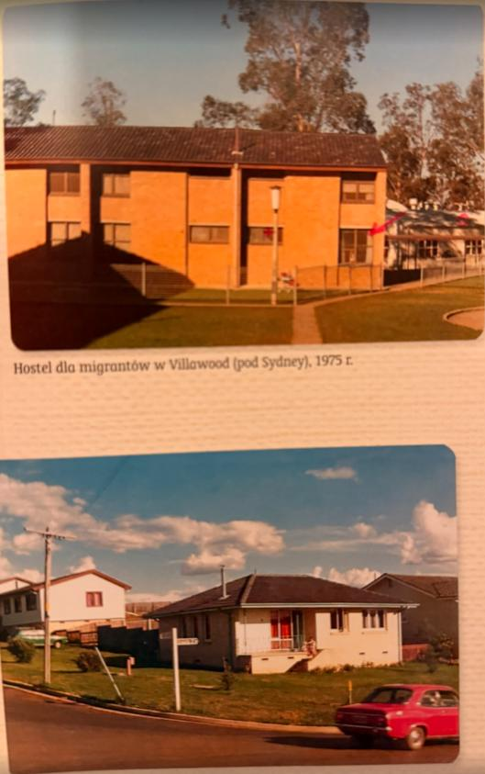


CHAPTER THREE · AUSTRALIA
A New Home in Sydney
18 June 1975
Hanna, Seweryn and their one-year-old son Adam landed at Kingsford Smith Airport to begin a new life.
Westbridge Hostel, Villawood
An old bus carried the migrants through Western Sydney to their first small apartment.
Learning a new language
“Our knowledge of English was abysmal” — they perfected the “th” sound before the bathroom mirror.

Slide 5
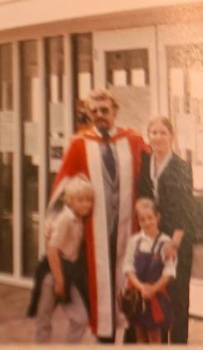
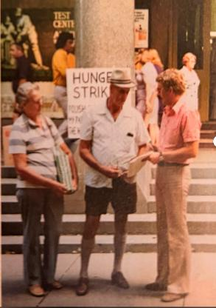
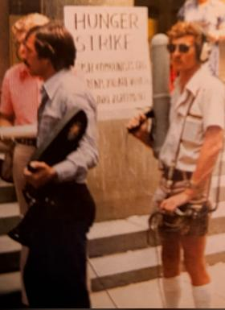

CHAPTER FOUR · NEW BEGINNINGS
Honest Work, Fresh Roots
Within three months the couple found work at the Ralph Symonds Plywood Factory in Homebush. Hanna worked as a quality technician; Seweryn — a trained lawyer and sociologist — pressed plywood on the night shift, the two alternating shifts to care for baby Adam.
Looking back, Australia gave us fantastic opportunities.

Slide 6




BECOMING A SCHOLAR
Earning His Credentials
From Polish degrees to a doctorate and a prestigious U.S. fellowship, Ozdowski rebuilt and extended his qualifications in his adopted home. Even as he had to relearn hi
1971
1973
1980
1984–86
Master of Laws (Hons.)
MA in Sociology (Hons.)
PhD, Sociology of Law
Harkness Fellowship
Adam Mickiewicz University, Poznań
Adam Mickiewicz University, Poznań
University of New England, Armidale
Harvard, Georgetown & UC Berkeley, USA

Slide 7



A LIFE OF SERVICE
Two Decades in Public Service
1971–73
1980–96
1996–2000
Polish Academy of Sciences
Australian Federal Government
South Australia
Research Officer, Institute of Legal Studies, Warsaw
Senior roles in the Attorney-General’s Dept, Prime Minister & Cabinet, and Foreign Affairs
CEO, Office of Multicultural & International Affairs, Adelaide

Slide 8
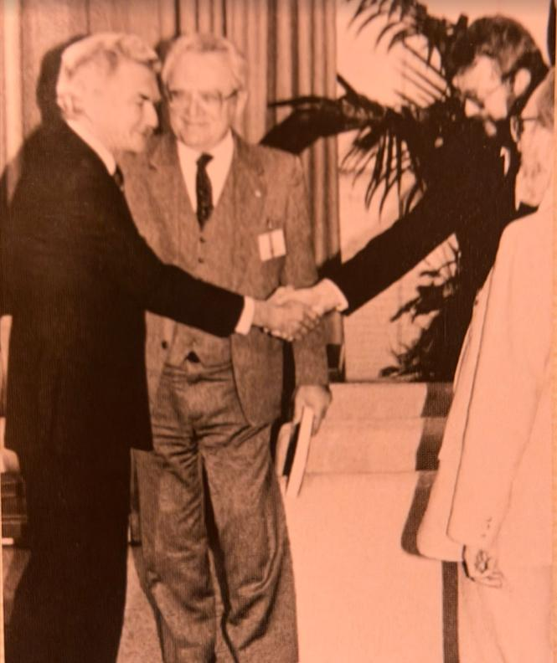
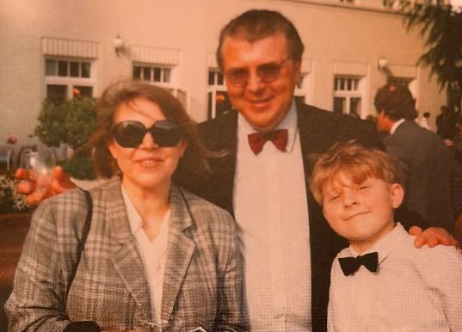
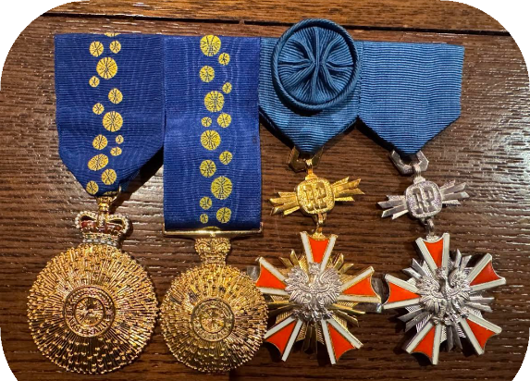

Slide 9
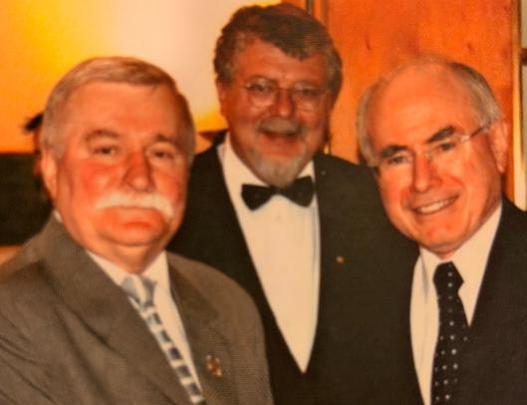

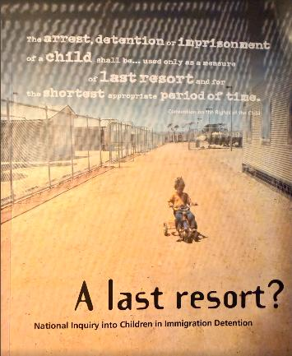


2000 – 2005
Champion of Human Rights
As Human Rights Commissioner and Disability Discrimination Commissioner, Ozdowski gave voice to those most often unheard.
“A Last Resort?” (2004)
His National Inquiry into Children in Immigration Detention sparked national debate and helped end the mandatory detention of children.
“Not for Service” (2005)
His National Inquiry into Mental Health Services drove major reform and funding increases across Australia.
On the world stage
Represented Australia in negotiating the UN Convention on the Rights of Persons with Disabilities.

Slide 10
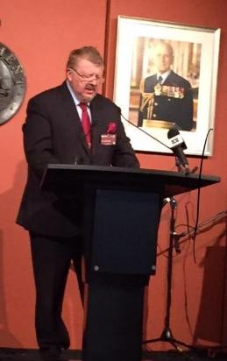
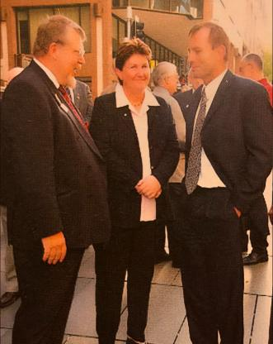
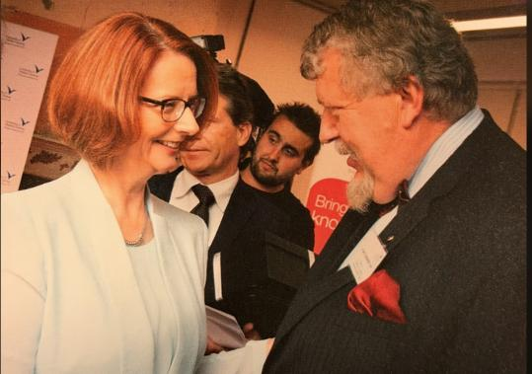
A BRIDGE BETWEEN NATIONS
Voice for Multiculturalism
Chair, Australian Multicultural Council
Led national multicultural policy, 2014–22
Supporter of Solidarity
Helped Poland regain independence in 1989 by backing the movement through the 1980s
Founder & educator
Australian Institute of Polish Affairs (1989); launched the International Human Rights Education conferences; Professor at Western Sydney University

Slide 11
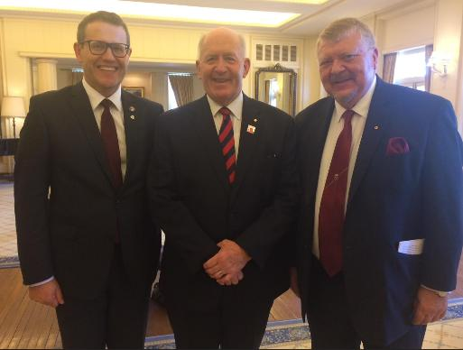
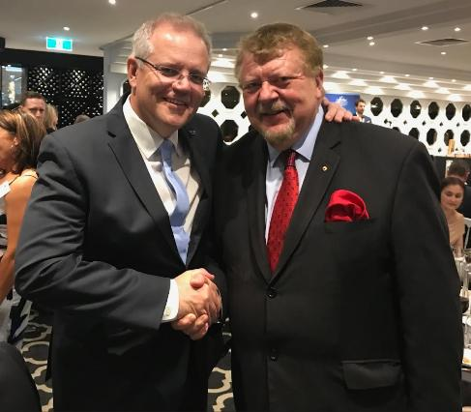
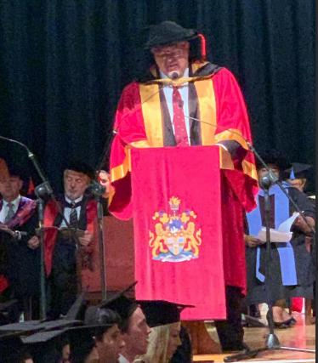
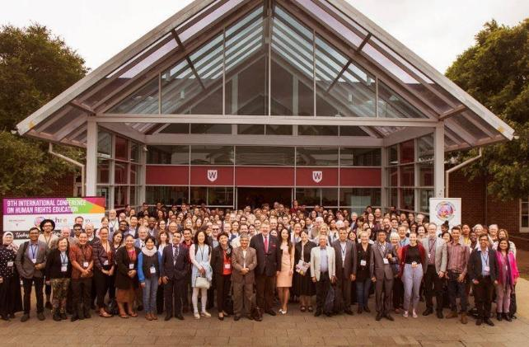
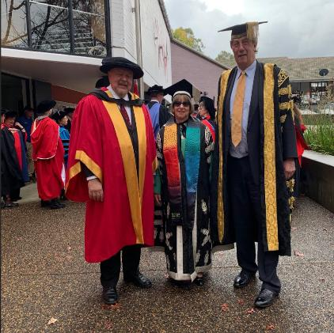

Slide 12





HONOURS & LEGACY
Recognised at Home and Abroad
AM
OAM
Order of Merit
Member of the Order of Australia, 2016 — for service to human rights & multiculturalism
Medal of the Order of Australia, 1995 — for service to the Polish community
Officer’s Cross of the Order of Merit of the Republic of Poland, 2007
Fifty great years in Australia — from pressing plywood on the night shift to shaping the nation’s conscience on human rights.
Professor Seweryn “Sev” Ozdowski AM • Refugee • Scholar • Human Rights Commissioner • Champion of Multicultural Australia

