Slide 1
National Human Rights Conciliation, Legal & Education Officers Conference Program Canberra, 24-25 October 2013 Developments in Human Rights Education Nationally and Internationally Address by Dr Sev Ozdowski OAM FAICD Australian Human Rights Commissioner (2000-05)

Slide 2
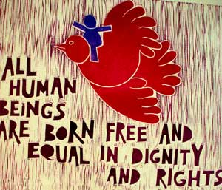

Slide 3
Why Human Rights Education (HRE)?
Common minimum standards
Secular standards
Importance of HRE in diverse society

Slide 4
Australian Council for Human Rights Education (ACHRE)

Slide 5
About the ACHRE
The ACHRE, formerly known as National Committee for Human Rights Education, was established in 1999 by a group of volunteers to actively pursue human rights education in Australia in response to the UN Decade on HRE (1995-04).
Patron-in-Chief
Her Excellency Ms Quentin Bryce AC CVO Governor-General of the Commonwealth of Australia

Slide 6
Key achievements of ACHRE
The registration of the Council in 1999.
Establishment of Chair in Human Rights Education at Curtin Uni in 2002.
Establishment of State and Territory networks and HRE Fund.
Provision of online human rights educational materials.
The ‘Citizen For Humanity’ Project launched at Parliament House Canberra in 2005.
Establishment of the National Centre for Human Rights Education at RMIT in 2007.
Submissions to Federal State and Territory Governments on human rights education.
Provision of HR training.
Initiation of national and international conferences, seminars and workshops.

Slide 7
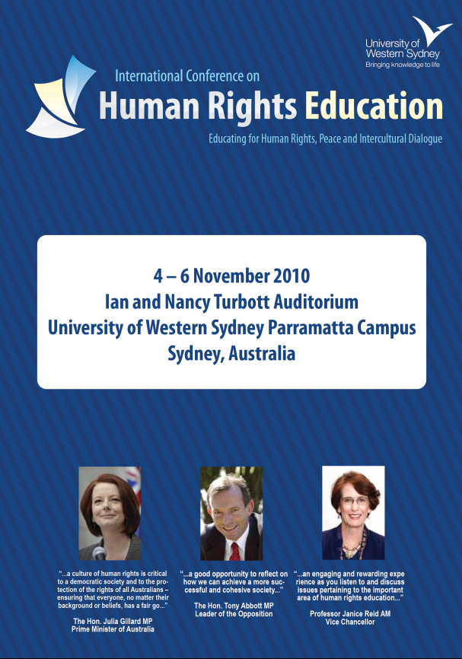
International Conference Series Human Rights Education
Inaugural Conference - Sydney, Australia 2010 http://www.humanrightseducationconference2010.com.au
2nd International Human Rights Conference – Durban, South Africa 2011
3rd International Human Rights Conference – Krakow, Poland 2012 http://www.hre2012.uj.edu.pl
4th International Human Rights Conference – Taipei, Taiwan 2013 http://scu.hre2013.org.tw
5th International Human Rights Conference – Washington DC, USA 2014

Slide 9
International Developments

Slide 10
What conventions matter to HRE?
The Universal Declaration of Human Rights,
the International Covenant on Economic, Social and Cultural Rights,
the Convention on the Elimination of All Forms of Discrimination Against Women,
the Convention on the Elimination of All Forms of Racial Discrimination,
the Convention on the Rights of the Child,
the Convention against Discrimination in Education.

Slide 11
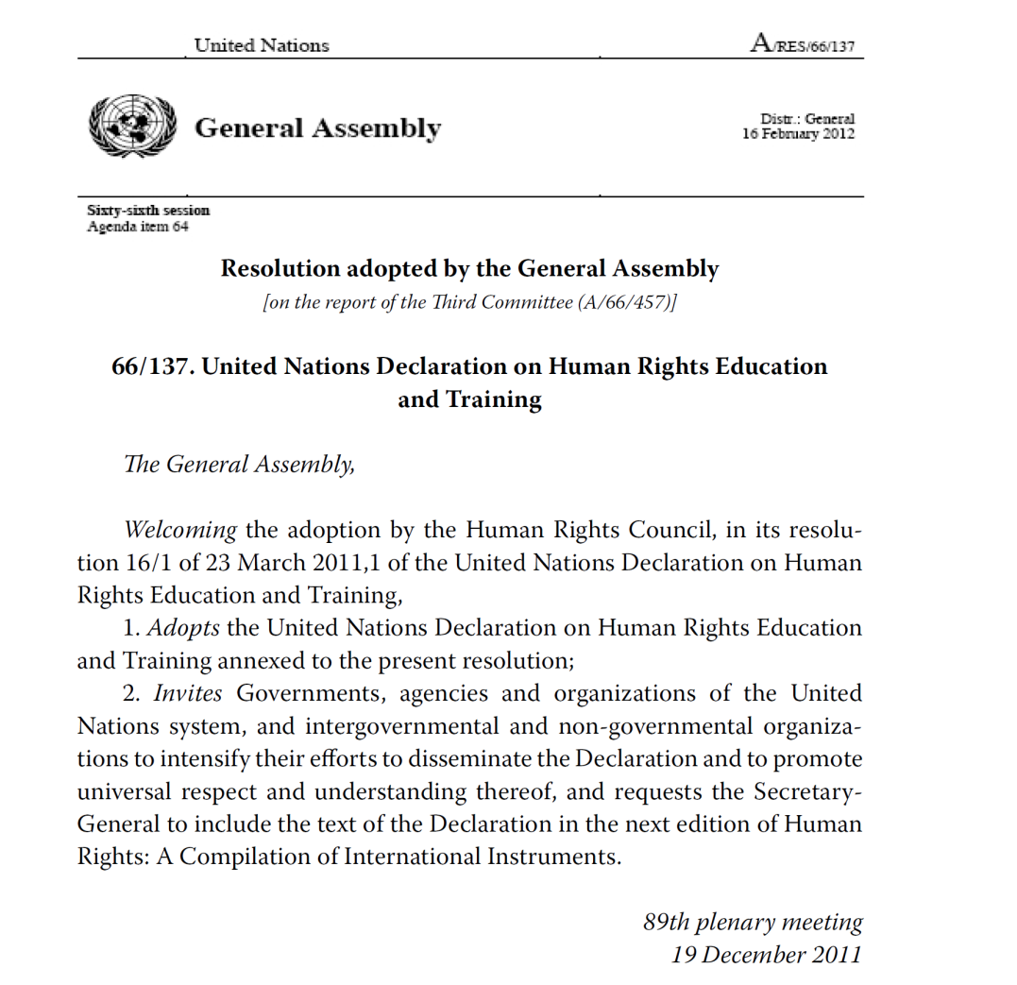

Slide 12
UN Declaration on Human Rights Education and Training 2012
Asserts that everyone has the right to know, seek and receive information about their human rights and fundamental freedoms,
defines HRET as comprising “all education, training, information, awareness-raising and learning activities aimed at promoting universal respect for and observance of human rights and fundamental freedoms”,
recognizes that HRET is a lifelong process that includes all parts of society,
Calls on all to intensify efforts to promote the universal respect and understanding of HRET.

Slide 13
UN World Programmes on HRE

Slide 14
UN Decade on HRE (1995–2004)
Provided a global framework through Plan of Action
But no reporting/monitoring
World HRE Program 1st Phase (2005–2009)
Has emphasis on the school curricula & education.
World HRE Program 2nd Phase (2010–2014)
focuses on those who further mentor tomorrow’s citizens and leaders, e.g. higher education institutions, government officials, the military.

Slide 15
World HRE Program 3rd Phase (2015–2019)
to focus on media professionals and journalists, with an emphasis on education and training in equality and non-discrimination.

Slide 16
HRE in Australia

Slide 17
Australian Legal System
No Bill of Rights
Australia is the only modern Western Democracy without a Bill of Rights
Bills of Rights known for HRE powers
Limited Constitutional Protection of HR

Slide 18
Rights Protected in Constitution
the right to vote (Section 41);
the right to a trial by jury in the State where the alleged federal offence took place (Section 80);
the denial of federal legislative power with respect to religion (Section 116); and
the prohibition against discrimination on the basis of State of residency (Section 117).

Slide 19
There are also two “economic rights”
s.92 guaranteeing freedom of interstate trade; and
s.51 mandating payment on just terms for property acquired by the Commonwealth.

Slide 20
The High Court implied rights
e.g. parliament cannot pass laws that adjudge a person to be guilty of a crime
Freedom to discuss in context of the election

Slide 21
The Constitution is silent on:
the fundamental freedoms such as the freedom of association, freedom of movement, freedom of peaceful assembly, freedom of thought, belief and opinion, and freedom from arbitrary arrest or detention;
the right to a fair trial or due process;
equality of all persons in Australia before the law.

Slide 22
Other Weaknesses
Decline in Importance of Common Law
Erosion of Habeas Corpus
Hindmarsh Island Bridge Case (1998) exchange between Justice Kirby and Commonwealth Solicitor General.
Justice Kirby asked, whether: “Under the “race” power of our Constitution, Nuremberg-style race laws or South African apartheid laws, if enacted by our federal parliament, would be binding?” The Solicitor General responded YES.
In other words, Federal parliament is free to legislate in a morally ambiguous way, so long as it stays within the Constitution’s head of power.

Slide 23
Parliament not the best protector of human rights
Westminster Systems favours strong Executive
weak separation of powers
Most of politicians do not believe into human rights
Majority rules
Party discipline

Slide 24
Popular Culture
Strong Australian civil society
“Rights of Passage” project
But focus on equality and not on civil liberties and freedom
Expanding “fair go” concept

Slide 25
HRE Programs in Australia
Federal Level
Anti-Discrimination Legislation
Age Discrimination Act 2004
Disability Discrimination Act 1992
Equal Employment Opportunity (Commonwealth Authorities) Act 1987
Equal Opportunity for Women in the Workplace Act 1999
Racial Discrimination Act 1975
Racial Hatred Act 1995
Sex Discrimination Act 1984

Slide 26
Federal Government Initiatives
2009 National Consultations on HR
HR Framework & HR Action Plan

Slide 27
2009 National Consultations on HR
The National Human Rights Consultation Committee (F Brennan)
66 community round tables
three days of public hearings
35,000 submissions
commissioned research, including a phone survey

Slide 28
Report with 31 recommendations to the AG on 30/09/09
Rec.1 HRE to be the highest priority for improving HR in Australia.
Rec. 4 An HR audit of all federal legislation, policies and practices.
Rec. 6 A statement of HR compatibility be required for all Bills.
Rec. 7 Joint Committee on HR to be established to review all Bills.
Rec. 8 A whole-of-government HR framework to be developed.
Rec. 18 Australia to adopt a federal Human Rights Act.
27 888 submissions were in favour & 4 203 were against.

Slide 29
Australia's Human Rights Framework
$18.3 million for implementation of govt response over 4 years
HRE - the highest priority – AHRC ($6.6M), grants, parliamentary scrutiny, etc.
New Parliamentary Joint Committee on Human Rights
Materials about HR in the public sector
No Human Rights Act or Charter - divisive
Develop National Action Plan on Human Rights

Slide 30
3rd National Human Rights Action Plan (2012)
Outlines what the Australian Government will do to improve HR
Built around an extensive evidence base
Reflecting the concerns of both Australians and the United Nations
in 2011, Australia participated in its first Universal Periodic Review before the UN Human Rights Council

Slide 31
The Action Plan’s key priority areas:
Establishing a National Disability Insurance Scheme,
Establishing a new National Children’s Commissioner (at AHRC)
Ratifying the Optional Protocol to the Convention Against Torture
People with a mental illness in the justice system
Reviewing reservations under the international human rights treaties
Living Longer Living Better aged care reform
Acknowledging the unique and special place of Australia’s First Peoples
implementing the National Anti-Racism Strategy (AHRC)

Slide 32
HRE at Australian Human Rights Commission

Slide 33
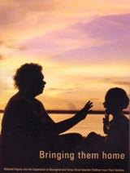
AHRC Inquiries
“Bringing them home” known as The Stolen Children report (1997)
“The National Inquiry Human Rights of People with Mental Illness” (Brian Burdekin - 1993)
“Not For Service - Experiences of Injustice and Despair in Mental Health Care in Australia” (2005)

Slide 34
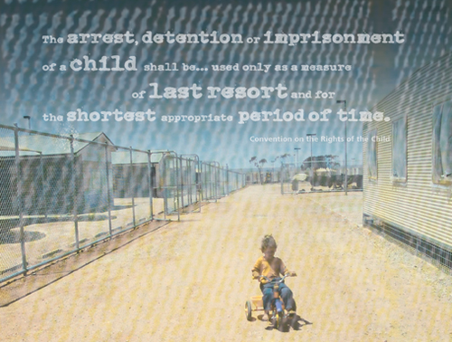
Children in Detention Inquiry
Tabled in Parliament on 13 May 2004.
No child shall be deprived of his or her liberty unlawfully or arbitrarily. The arrest, detention or imprisonment of a child shall be in conformity with the law and shall be used only as a measure of last resort and for the shortest appropriate period of time.
Convention on the Rights of the Child, article 37(b)

Slide 35
HRE in Australia
State Level
You know it best
States with The Bill of Rights
Victoria & ACT

Slide 36
School Curricula

Slide 37
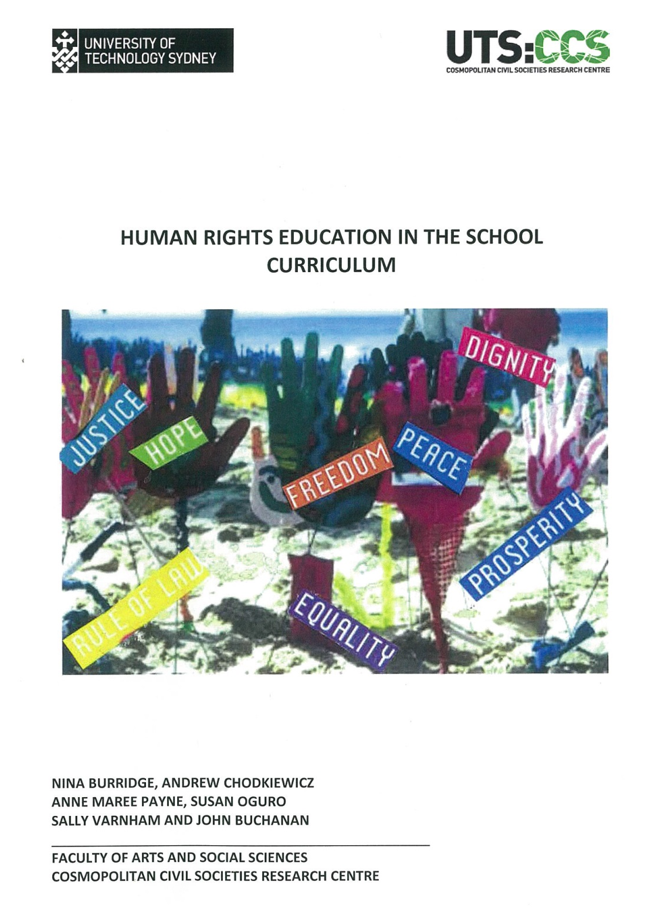

Slide 38
Human Rights Education in the School Curriculum Report
The transformative potential of human rights education to challenge existing systems and pedagogical practices remains largely untapped in the school environment. The important issue of children's rights remains contentious, with some schools seemingly reluctant to teach students about their rights.

Slide 39
In the absence of an effective integration of human rights education into the new national curriculum, Australian schools are likely to continue to find it difficult to prioritise human rights issues to the extent necessary to have a sustained impact on student learning.

Slide 40
Other Players
Employers
Public Employers – PSC
Large Mining Companies
Rio Tinto
Universities

Slide 41
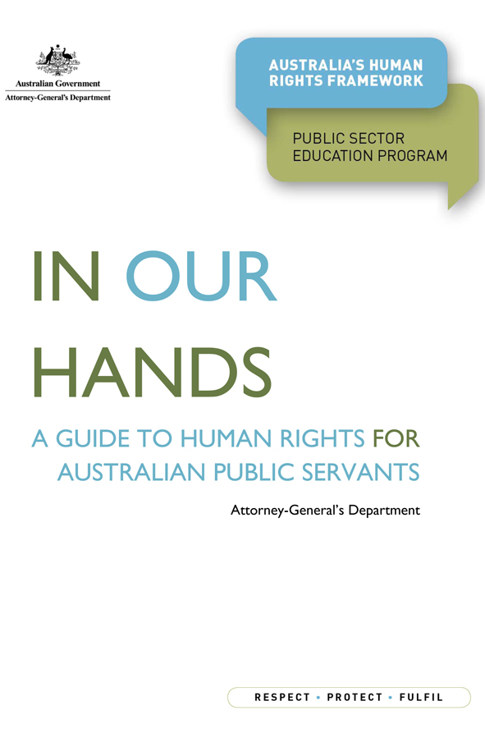
APS Values, Employment Principles and Code of Conduct

Slide 42
Employers – Large mining companies
BHP Billiton Iron Ore Indigenous Traineeship Programs
Rio Tinto Alcan Weipa Indigenous mining agreement and Woodside Indigenous Operations Support Traineeship

Slide 43
Universities
Centres for Human Rights Education (Curtin, UTS, CPACS – Sydney, others)
Internal governance – E&D
EOWA Employer of Choice

Slide 44
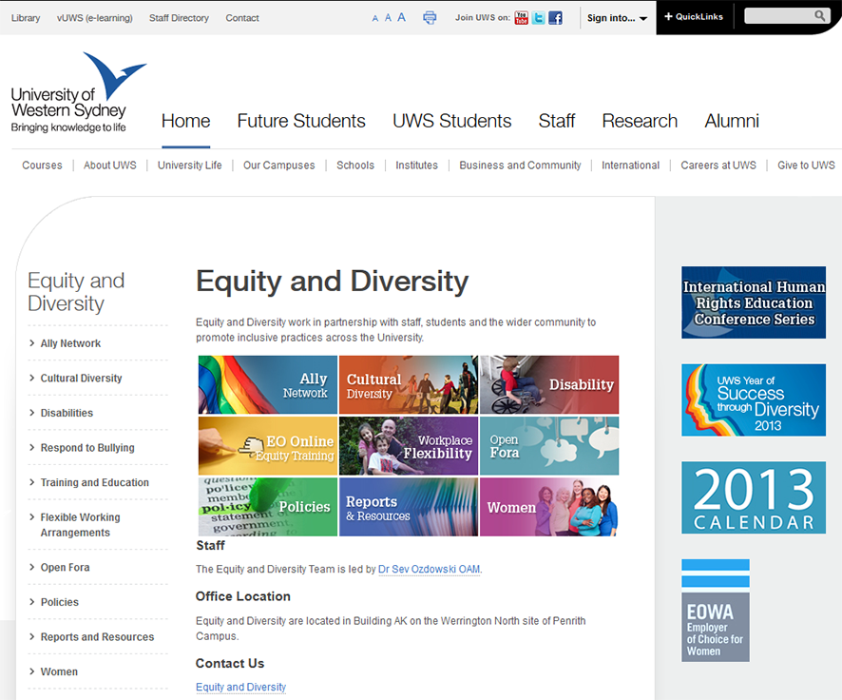
UWS

Slide 45
UWS

Slide 46
Other Players
NGOs
ACHRE
Amnesty International
Church of Scientology
Asylum Seekers organisations
Disability organisations
Gender & Sexuality NGOs
Employment – Discrimination, bullying etc.

Slide 47
The Way Forward
The Unlikely Wish List
Australian Bill of Rights
New Resources for HRE
Changes to School Curricula

Slide 48
Opportunities for HRE
Third Phase of the UN World Programme on HRE
NGOs
Schools
HR Topical Issues

