Slide 1
Sydney 2013 Quo Vadis Conference "Connecting Tomorrow's Future" Rydges Hotel, 4 - 6 October 2013 “Heritage and participation in a new society - a personal journey” Address by Dr Sev Ozdowski OAM FAICD Australian Human Rights Commissioner (2000-05)

Slide 2
CHILDHOOD INFLUENCES

Slide 3
Ozdowski Family Residence Roszków near Jarocin 1938

Slide 4
First Communion of Jerzy Ozdowski Roszków 1938

Slide 5
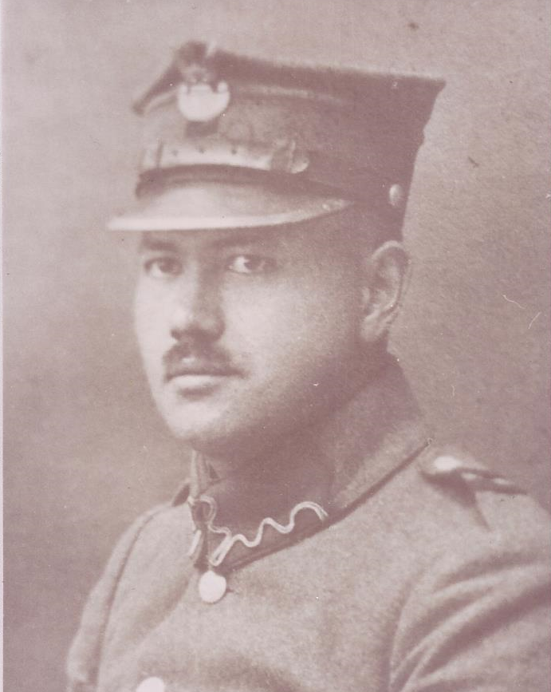
Stanisław Chylewski (1888-1940) in uniform of Greater Poland Uprising 1918-19

Slide 6
Sev Ozdowski as an Altar Boy Poznań Fara Church 1961

Slide 7
FORMATIVE YEARS 1964 - 1973

Slide 8
Student Fest “Juvenalia” in Poznań 1969

Slide 9
Research into Workers Unrest in Costal Cities of Poland in December 1970

Slide 10
MIGRATION AND EARLY SETTLEMENT

Slide 11
German Fremden-Pass for travel to Australia 1974

Slide 12
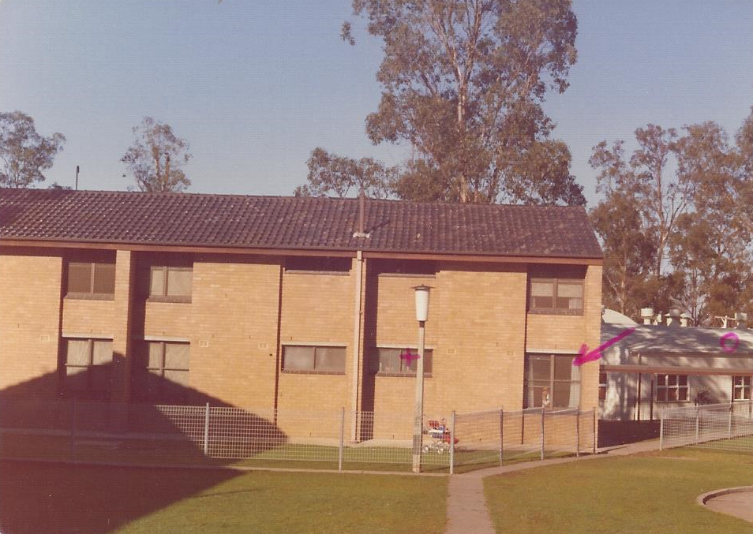
First Home: Villawood Migrant Reception Centre 1975

Slide 13
PROFESSIONAL BEGINNINGS

Slide 14
Hunger Strike in Martin Place, Sydney March 1977

Slide 15
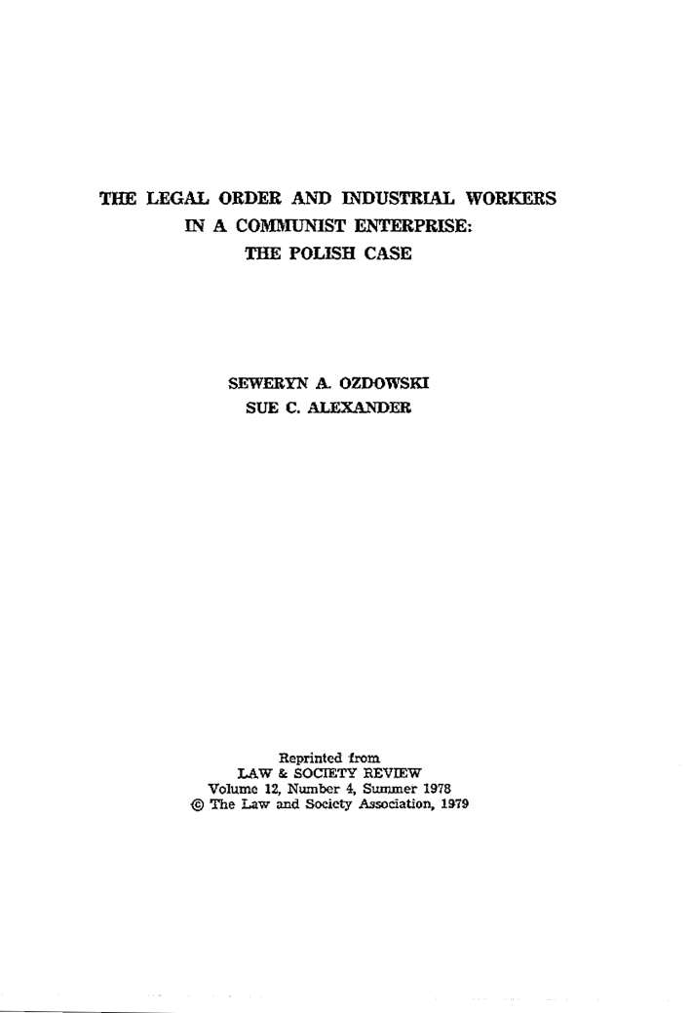
First Publication in an Internationally Recognised Law Journal 1979

Slide 16
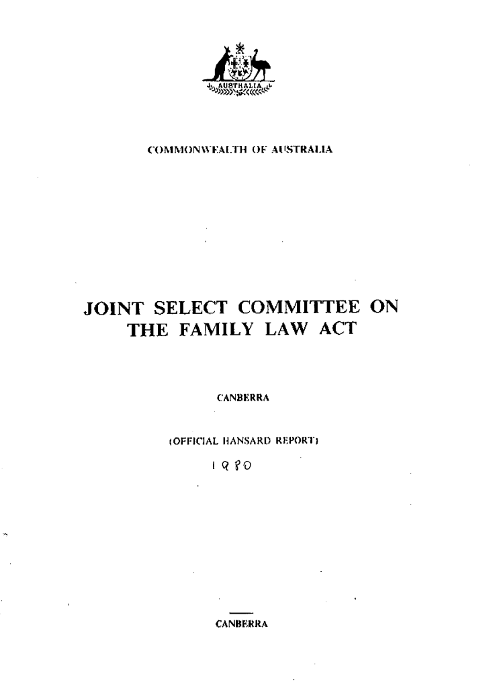
First Submission Made to Parliamentary Committee 1980

Slide 17
AUSTRALIAN PUBLIC SERVICE

Slide 18
Dame Roma Mitchel, Chair of the Human Rights Commission (1981-6), then South Australian Governor - Adelaide 1996

Slide 19
First Parliamentary Report

Slide 20
Article in a Conservative Intellectual Journal “Quadrant” 1987

Slide 21
Demonstration in front of the Polish Embassy in Canberra 1981

Slide 22
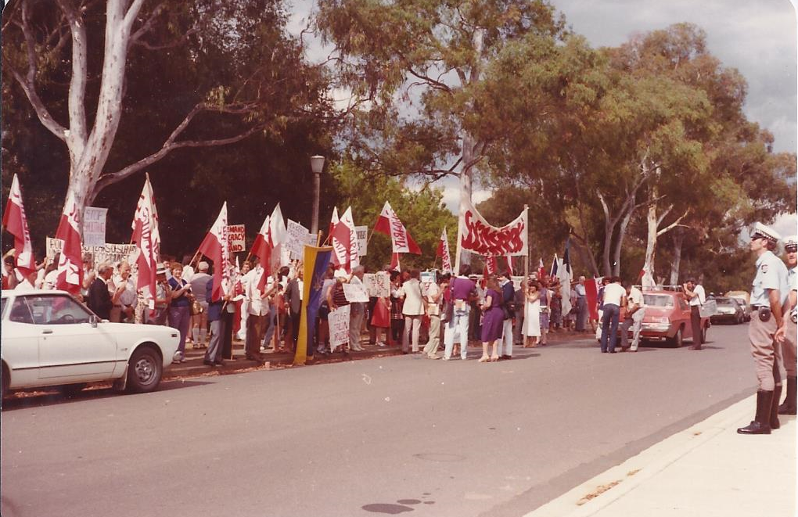
Demonstration in front of the Polish Embassy in Canberra 1981

Slide 23
Office of Multicultural Affairs with Prime Minister Bob Hawke 1988

Slide 24
The “Bible” of Australian Multiculturalism

Slide 25
Foreign Minister Gareth Evans with Australia Indonesia Institute team 1990

Slide 26
On assignment for BHP Utah Minerals International in Moscow 1990-01

Slide 27
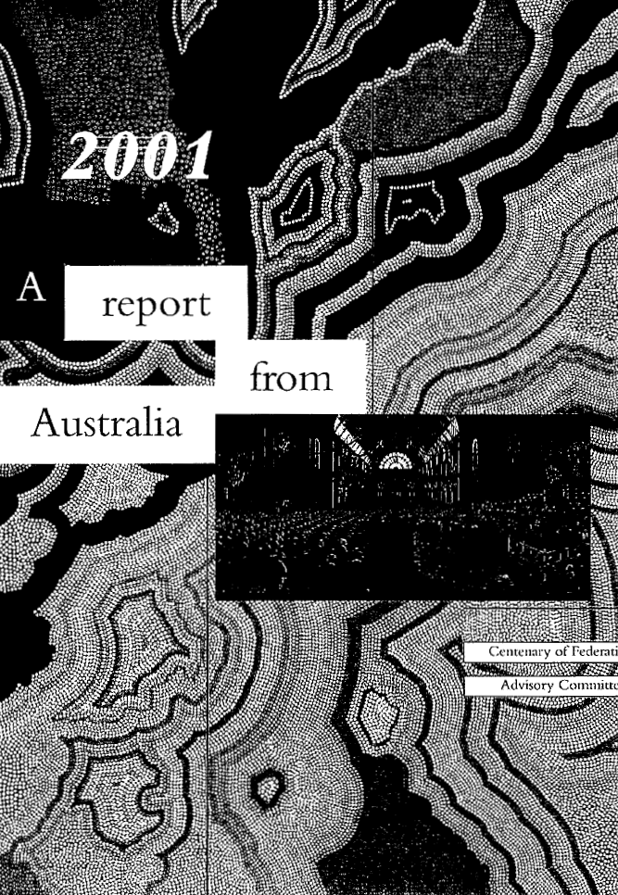
Let’s Celebrate the Centenary of Australian Federation

Slide 28
IN SOUTH AUSTRALIA

Slide 29
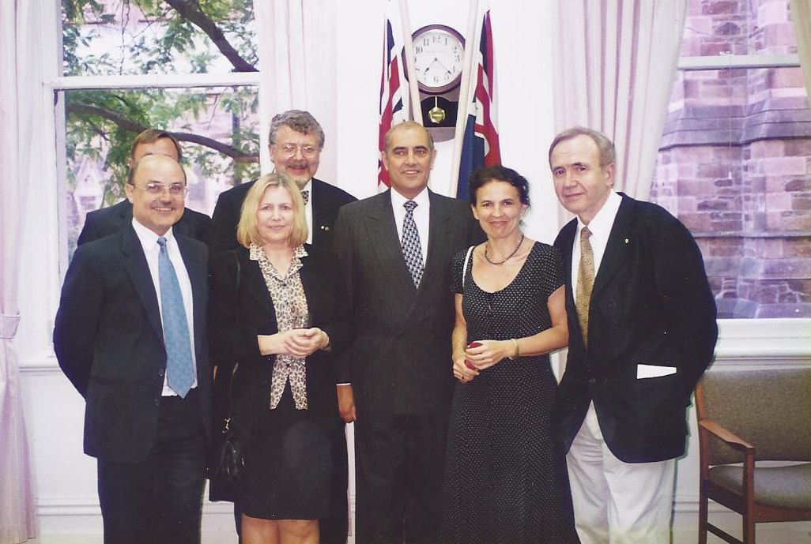
Premier John Olsen with the Polish Lobby at the Office of Multicultural and International Affairs Adelaide 1998

Slide 30
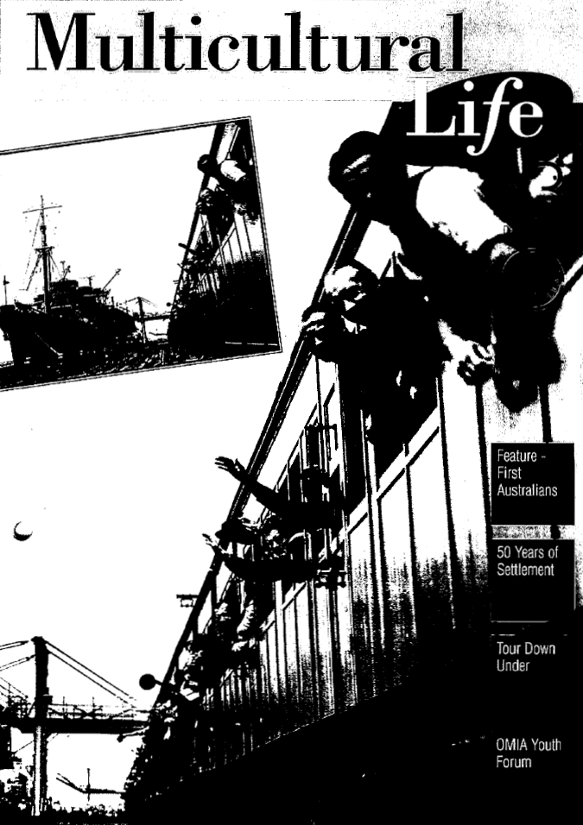
Advancing Multicultural Policies and Skilled Migration Adelaide, 1996-2000

Slide 31
AUSTRALIAN HUMAN RIGHTS COMMISSIONER

Slide 32
Fighting to Secure Release of Children and their Families from Immigration Detention, 2004

Slide 33
Opening Medicare to People with Mental Illness

Slide 34
NEW BEGINNING

Slide 35
Hon. Michael Kirby AC CMG Addressing UWS Open Forum 2009

Slide 36
2010 International Human Rights Education Conference Program Cover

Slide 37
Hon. Christopher Pyne MP, now Minister of Education at IHRE Conference in Sydney, 2010

Slide 38
Lobbying Prime Minister Julia Gillard MP for Human Rights 2013

Slide 39
THE POLISH LOBBY

Slide 40
Prime Minister Bob Hawke with Leaders of the Polish Community 1990

Slide 41
President Lech Wałęsa and Prime Minister John Howard Canberra 2002

Slide 42
President Lech Wałęsa with Cardinal George Pell Sydney 2002

Slide 43
Adam Michnik at White Eagle Club Canberra 1990

Slide 44
Deputy Prime Minister (and later Australia's Ambassador to Vatican) Tim Fisher offers a Koala bear to Hon. Hanna Suchocka at Australian Parliament House, Canberra 1992

Slide 45
Foreign Minister Krzysztof Skubiszewski at Polish Ex-Servicemen’s Club Canberra 1990

Slide 46
Premier Jan Krzysztof Bielecki with Senate President Margaret Reed Canberra 2003

Slide 47
Jan Nowak Jeziorański with Philip Ruddock MP at Parliament 1990

Slide 48
Jan Karski at Parliament House waiting for a meeting with Prime Minister early 1990s

Slide 49
Prof. Leszek Balcerowicz Sydney 2010

Slide 50
MAINTAINING HERRITAGE

Slide 51
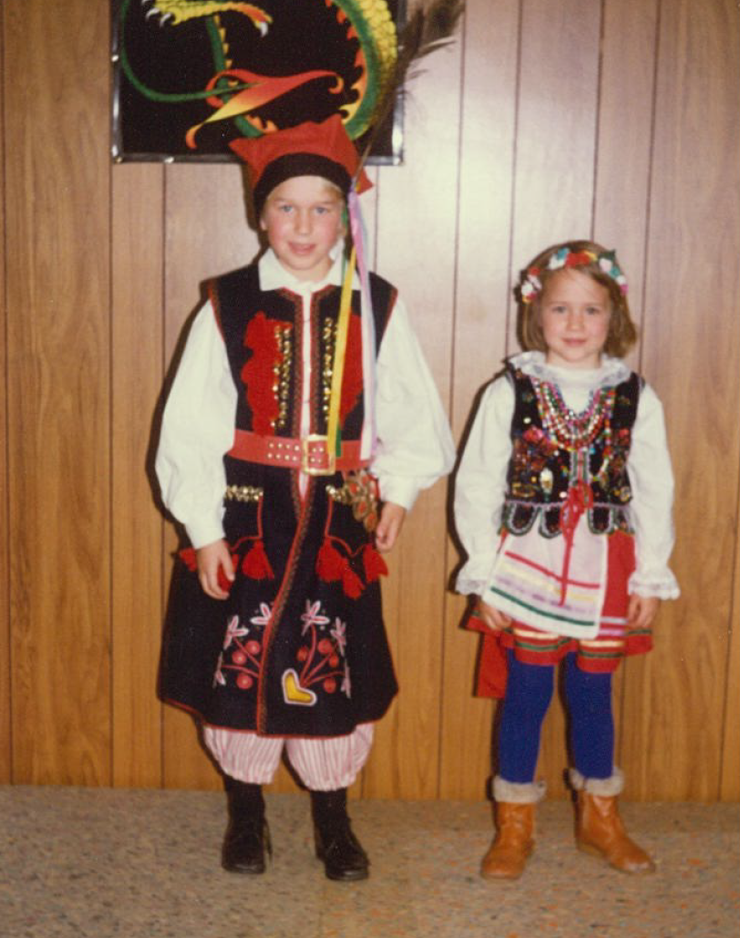
Adam and Agata Ozdowski Canberra 1984

